Slide 1
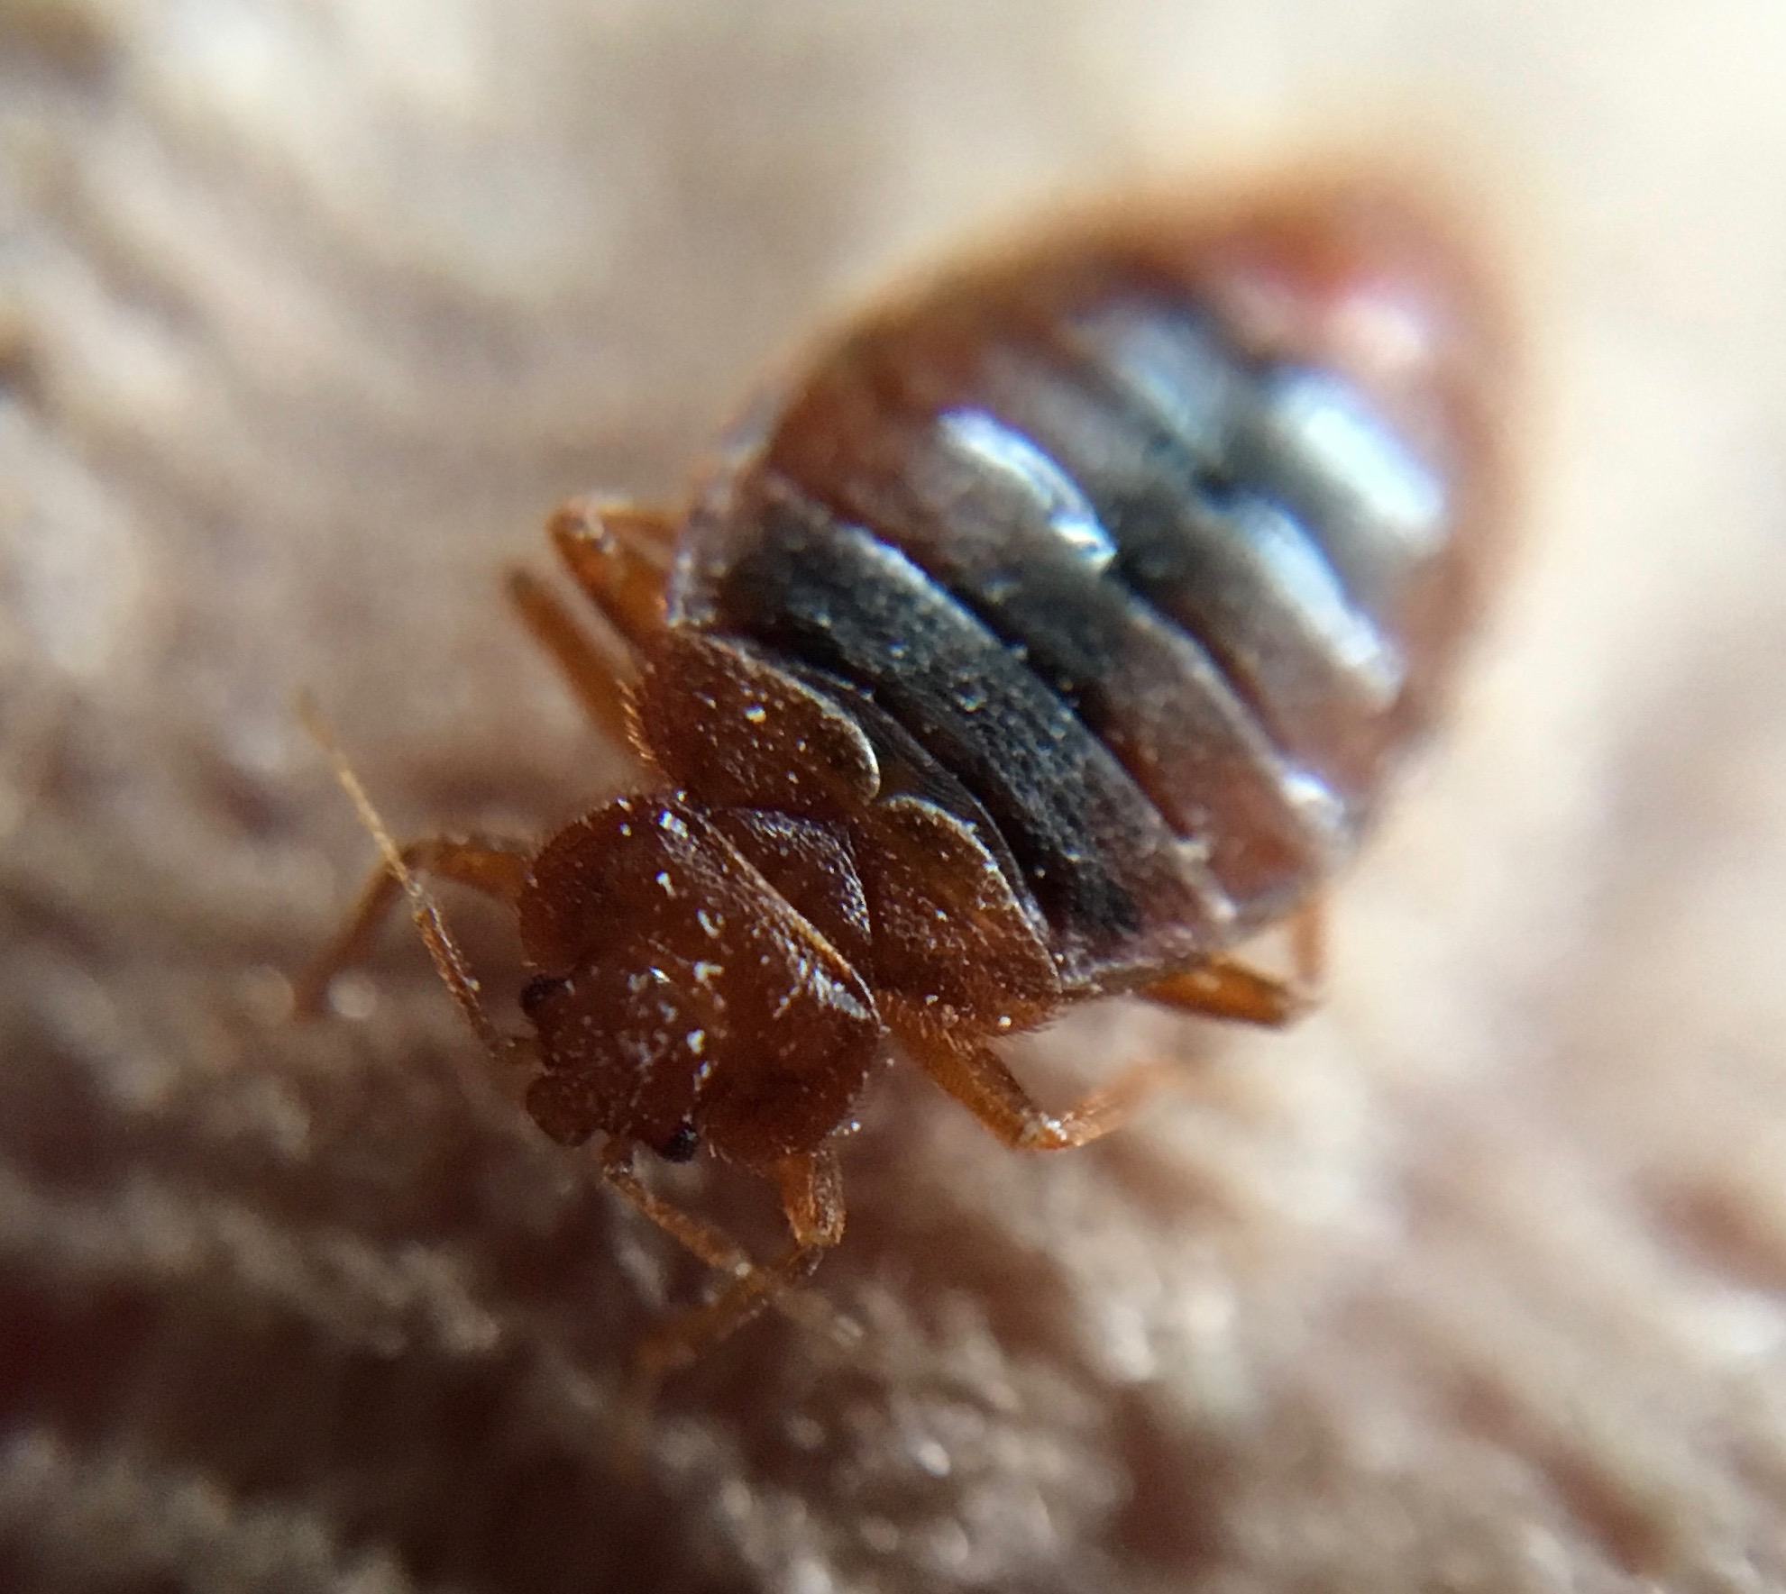

Introduction to Bed Bugs
This IPM training program was developed by a partnership including the U.S. Department of Agriculture National Institute of Food and Agriculture, the U.S. Department of Housing and Urban Development, the U.S. Environmental Protection Agency, Centers for Disease Control and Prevention, the Pennsylvania IPM Program, the National Pest Management Association, the National Center for Healthy Housing, and the Regional IPM Centers.
Funding was provide by EPA, HUD, CDC, and USDA-NIFA.
The materials contained herein present a research-based, balanced, and objective approach to pest management in affordable housing and are intended to be used in their entirety. Any nonobjective or partial use of the materials is not recommended. Products, vendors, or commercial services mentioned or pictured in the trainings or presentations are for illustrative purposes only and are not meant to be endorsements.
Notes:
Rev. 8-10-17
This presentation focuses on bed bugs. It covers the biology, behavior, and what you should do up to the point where the PMP gets involved. From there, follow the pest control company's procedure.
Reference: For an evaluation of bed bug control options, see: http://www.nchh.org/Portals/0/Contents/bedbug_report.pdf

Slide 2
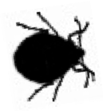
Outline
What they are
What they eat
Where they live
How to think like a
bed bug
Prevention
Monitoring and inspection
Assessment-based control
Also known as…
chintzes or chinches
mahogany flats
red coats
crimson ramblers
wall lice
the bug that nobody knows
Notes:
2
This is the outline for the presentation.

Slide 3
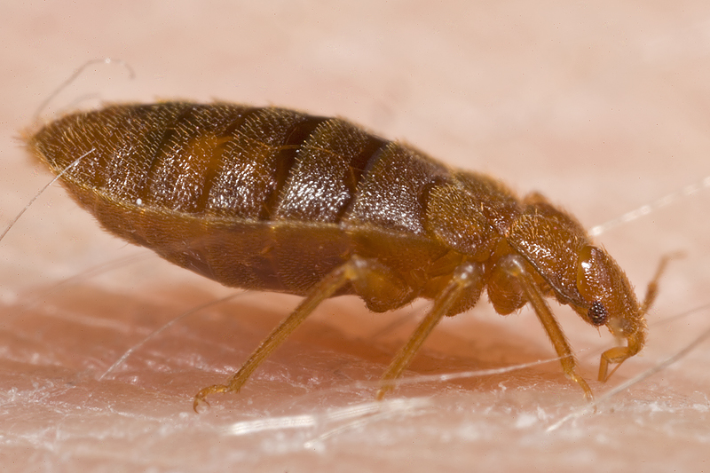
What is a bed bug?
A blood-sucking insect
Flat
Range in size from a sesame seed to an apple seed
Light brown to mahogany red (depends on when they last fed)
An adult bed bug feeding on a human

Slide 4
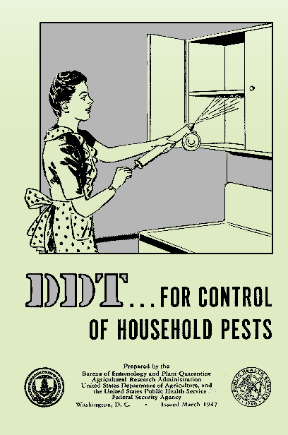
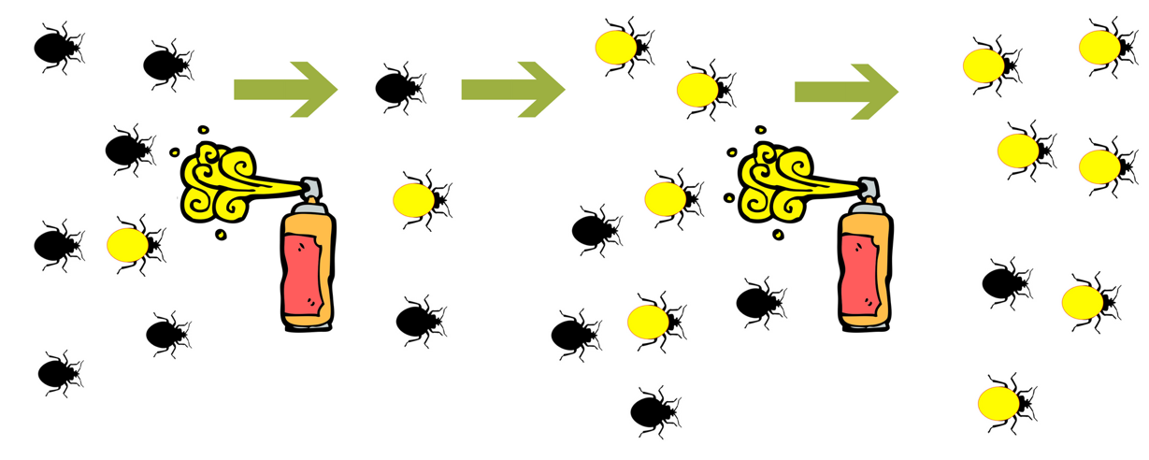
Why they're back
Change in pesticide availability
Change in pesticide use patterns
More travel/ mobility of people
More infested locations
Lack of preparedness of society in general
Pesticide resistance
Pesticide resistance:
Within 2-20 years insects show resistance to new pesticides (including DDT)
More pesticides are needed to kill bugs
PMPs must rotate chemicals
Notes:
No one reason is to blame for the increase in bed bug infestations. They were never fully gone, but a bed bug treatment was uncommon for pest control companies. The rise has been referred to at "the perfect storm." Most likely it is a combination of all these factors that resulted in the situation we are dealing with today. Bed bugs are back, regardless of how they got here.
Pesticide Resistance: An insect (yellow) survives a chemical application and passes those genes on to next generation
By the 1960’s bed bugs resistant to DDT were found worldwide

Slide 5
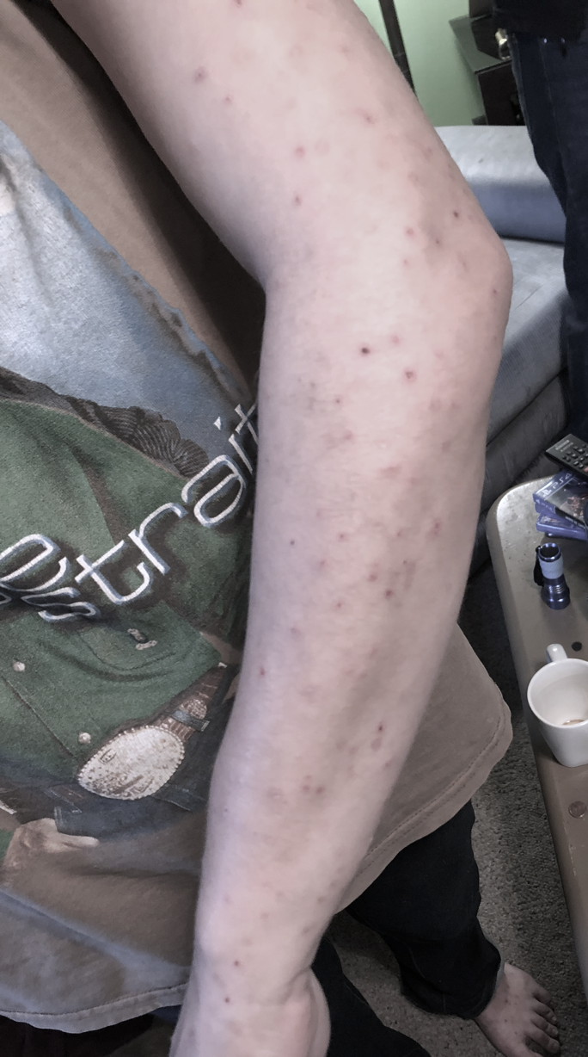
Bed bugs are a pest of public health significance
Result in stress, loss of work, loss of productivity, loss of sleep, and financial burden
Cause secondary infections after people scratch their bed bug bites
Are unwelcome in our homes and workplaces
Bed bugs do not transmit disease under normal living conditions.
Notes:
5
Although bed bugs have not been shown to transmit disease, they do have an effect on physical and mental health. In 2010 EPA and CDC issued a joint statement, classifying bed bugs as a "pest of significant public health importance.”
Dr. Dawn Gouge clarifies: Bed bugs do not transmit disease under normal living conditions
They can vector a number of bacterial pathogens e.g., Q fever and trench fever pathogens.
Physical effects could result from scratching the welts that show up on some people from the bed bug bite. The elderly and children may not have the self control to stop scratching and infection can result.
Many people with bed bugs cannot sleep and suffer negative effects. The stress from having bed bugs, having to treat them, and having to pay for it can take a significant toll.

Slide 6
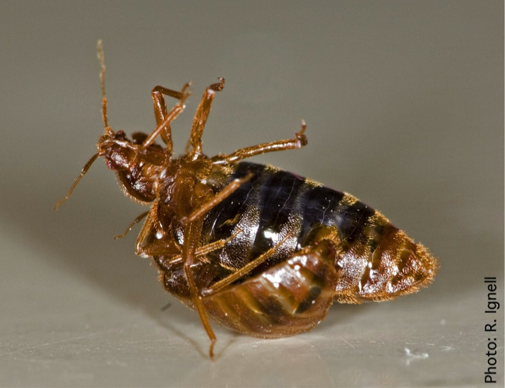
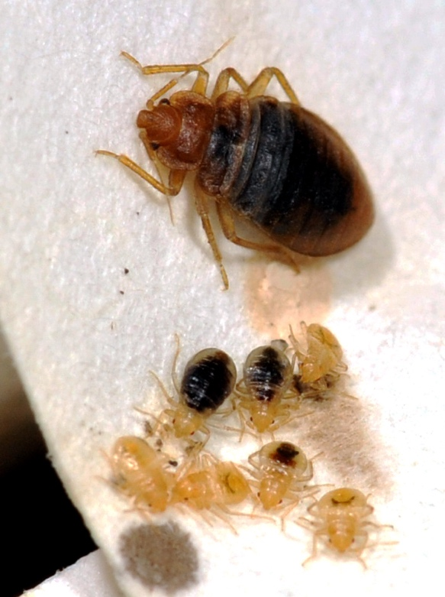
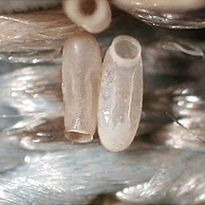
Biology
Female bed bugs lay less than 200 eggs in a lifetime; 1-5 eggs per day.
From egg to adult – 5 weeks to 4 months
Molt 5 times; feed before each molt
Bed bugs mating
Photo: Alex Yelich
Adult and nymphs
Close up of eggs
Notes:
Pictures?

Slide 7
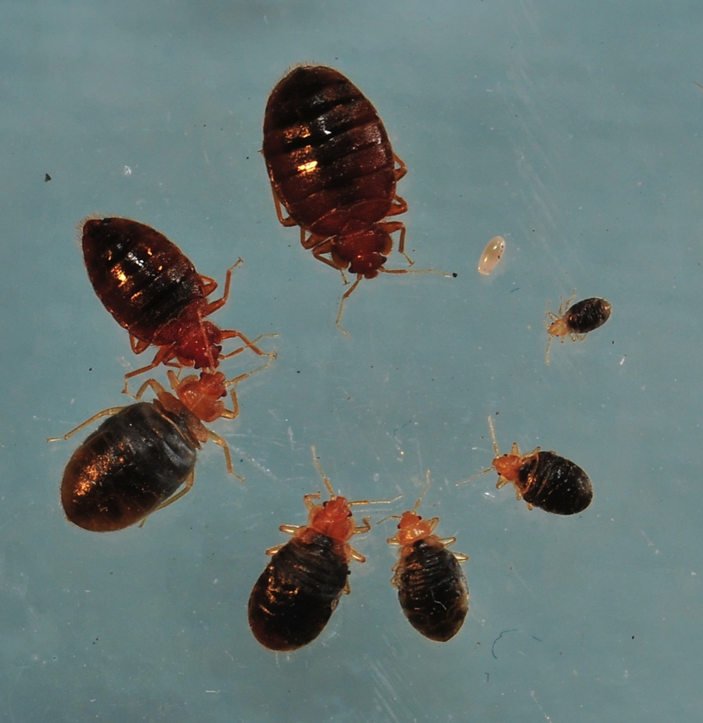
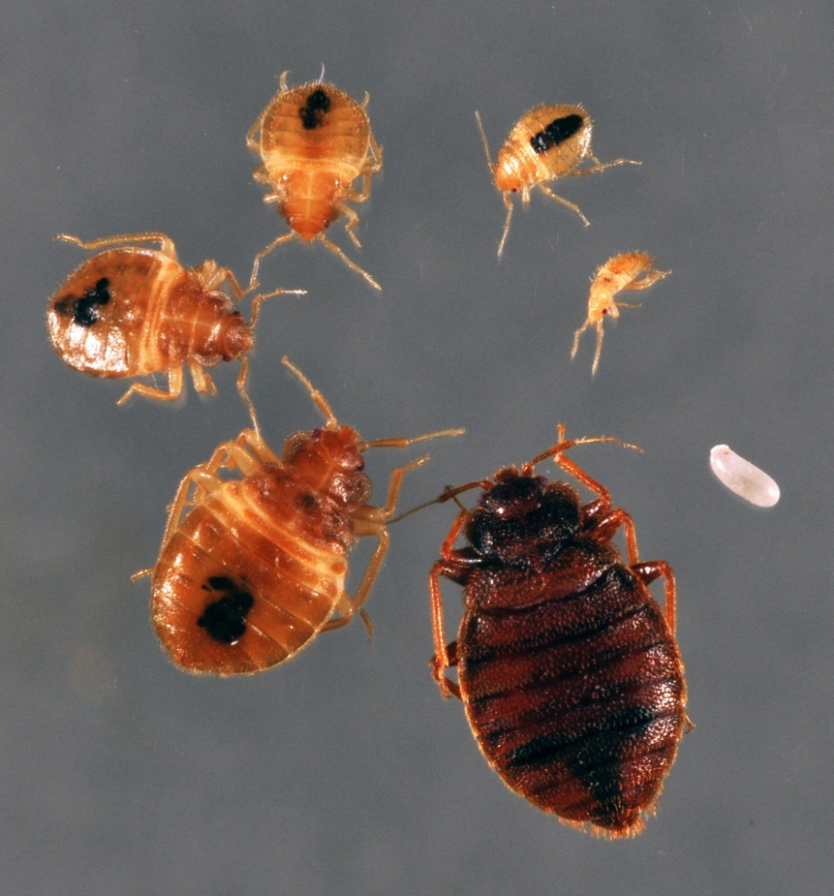
Bed bug life cycle
Fed
Not recently fed
Notes:
Bed bugs can be two different shapes, depending on when they last fed. They expand when full of blood and quickly (within a few hours) digest the blood and poop out the excess so that they are flat again. A recently fed bed bug will be plump, but after it digests it is back to being flat.
Like cockroaches, baby bed bugs look like the adults, only smaller.

Slide 8
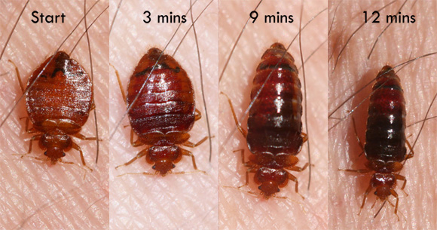
The feeding process
Photo: Whitney Cranshaw
Notes:
Mike Merchant’s slide
Note that during feeding the adult bed bug’s body becomes distended with blood. This is normal. Not all bed bugs will look exactly alike.

Slide 9
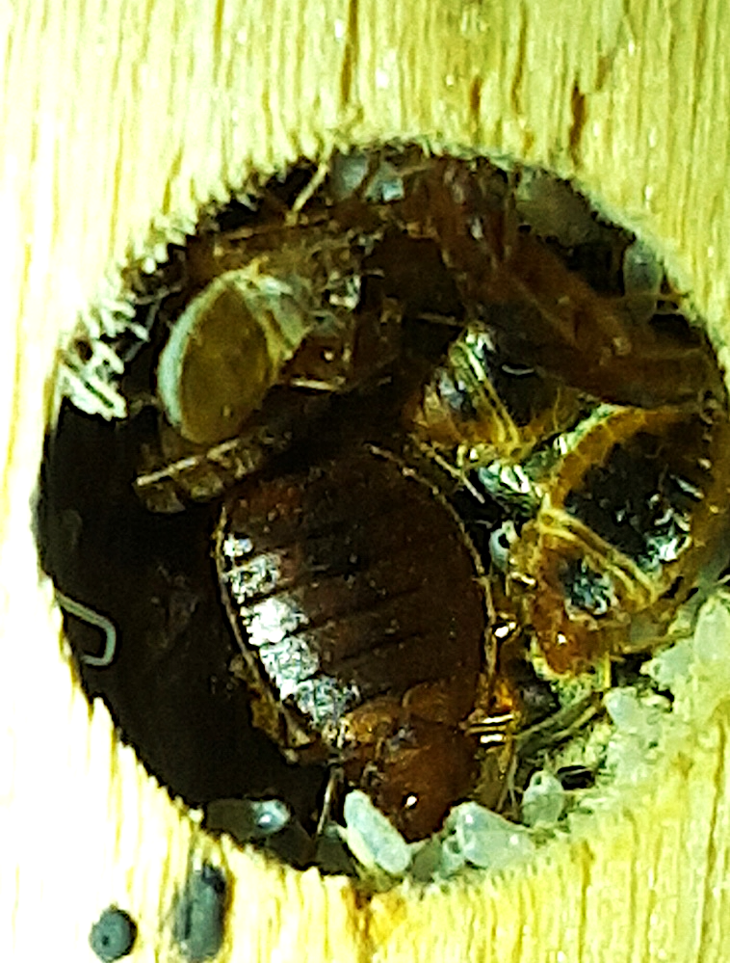
Bed bug behavior
Most active at night
Hide in cracks and crevices, often in groups
Cannot fly, jump, or burrow into skin…they crawl
Hitchhike on coats, bags, furniture, wheelchairs…
Photo: Dr. Dawn Gouge
Bed bugs hiding in a screw hole
Notes:
9
Bed bugs will wedge into any crack that a credit card edge can fit into.
Although they are usually active at night, bed bugs will feed during the day if hungry. Most of the time, they are hiding in cracks and crevices near where they last fed. Usually where there is one, there will be more, but they are not dependent on each other, so “loners” can occur. Hiding spots can be in the furniture where people sleep (sofas, recliners, mattresses, box springs, and bed frames), the furniture next to the bed, lamps, alarm clocks, picture frames on the walls, baseboards, the edges of the carpets, electric outlets, and draperies.
They can get into other units and be carried home by staff members by hitchhiking on bags and used furniture (especially stuff that was picked up from trash) or by crawling into new units through walls.
Bed bugs will always be found crawling, never flying, jumping, or burrowing.

Slide 10
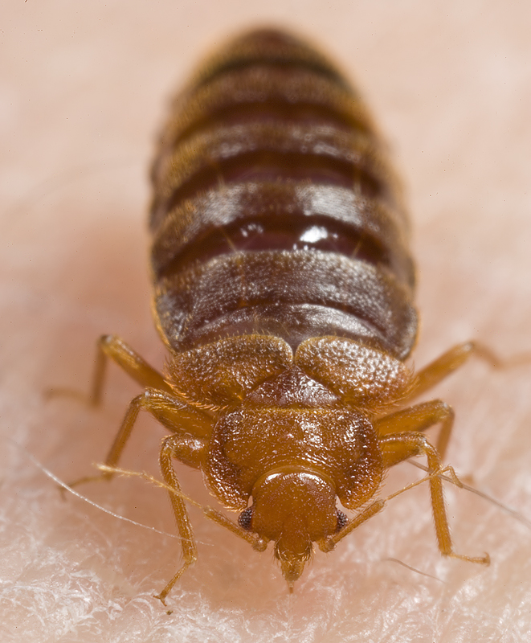
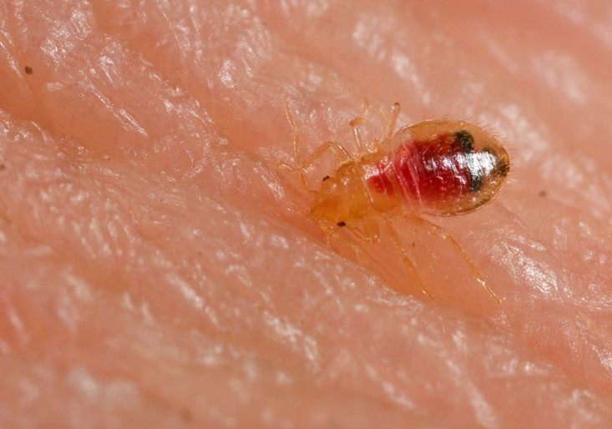
What bed bugs eat and drink
Blood
Notes:
10
Unlike cockroaches and rodents, bed bugs get both their food and water needs from blood. If there is a warm body, they can be happy. The baits intended for cockroaches and rodents will not work on bed bugs because bed bugs do not have chewing mouthparts to eat the bait. Also, boric acid (a stomach poison) will not work for bed bugs since they will not ingest it.

Slide 11
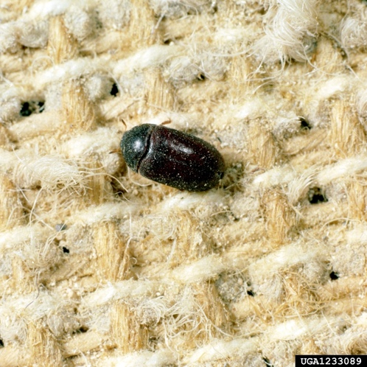
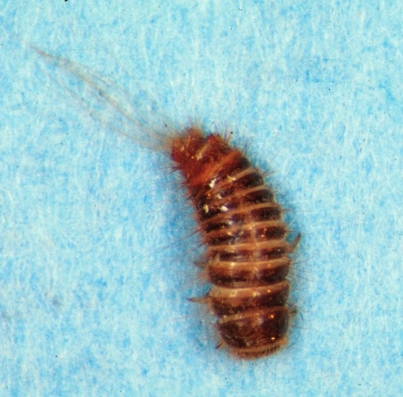
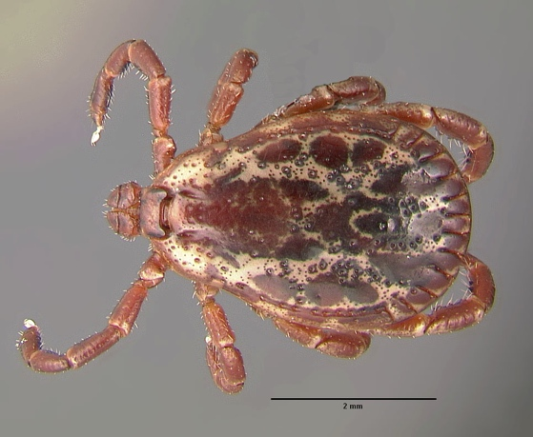
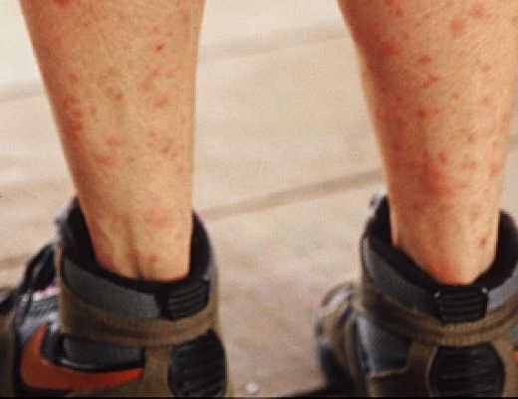
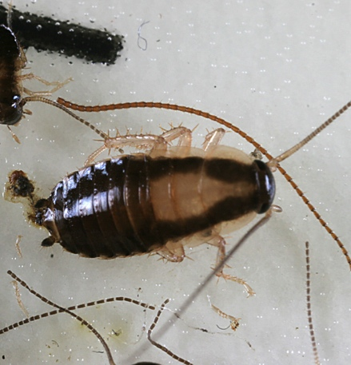
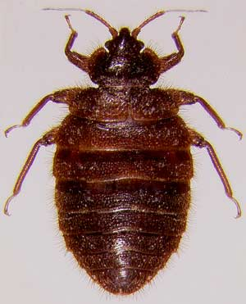
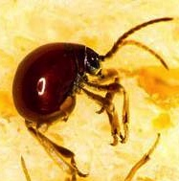
Can be confused with…
Carpet Beetle and larva
Tick
Mosquito Bites
Cockroach Nymph
Bat Bug
Spider Beetle
Notes:
The photos are of a tick, mosquito bites, a cockroach nymph, a bat bug, and a spider beetle a few of the insects that have been found in the homes of people who thought they had bed bugs. Proper identification can save time, anxiety, and money. The only way to confirm bed bugs is to find live bed bugs, collect a few, and have a professional identify them.

Slide 12
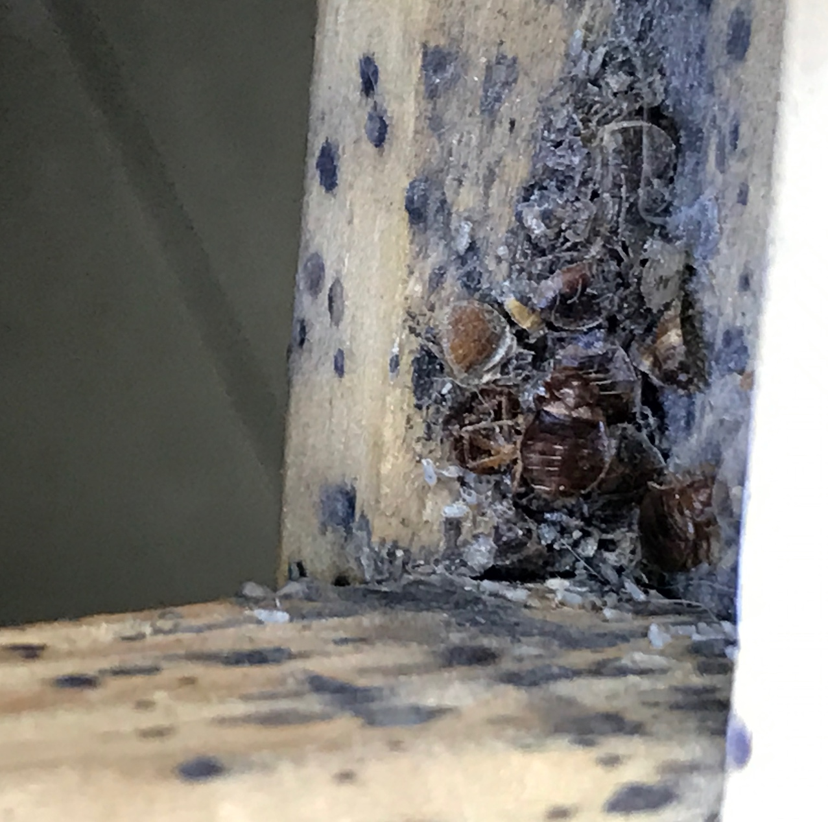
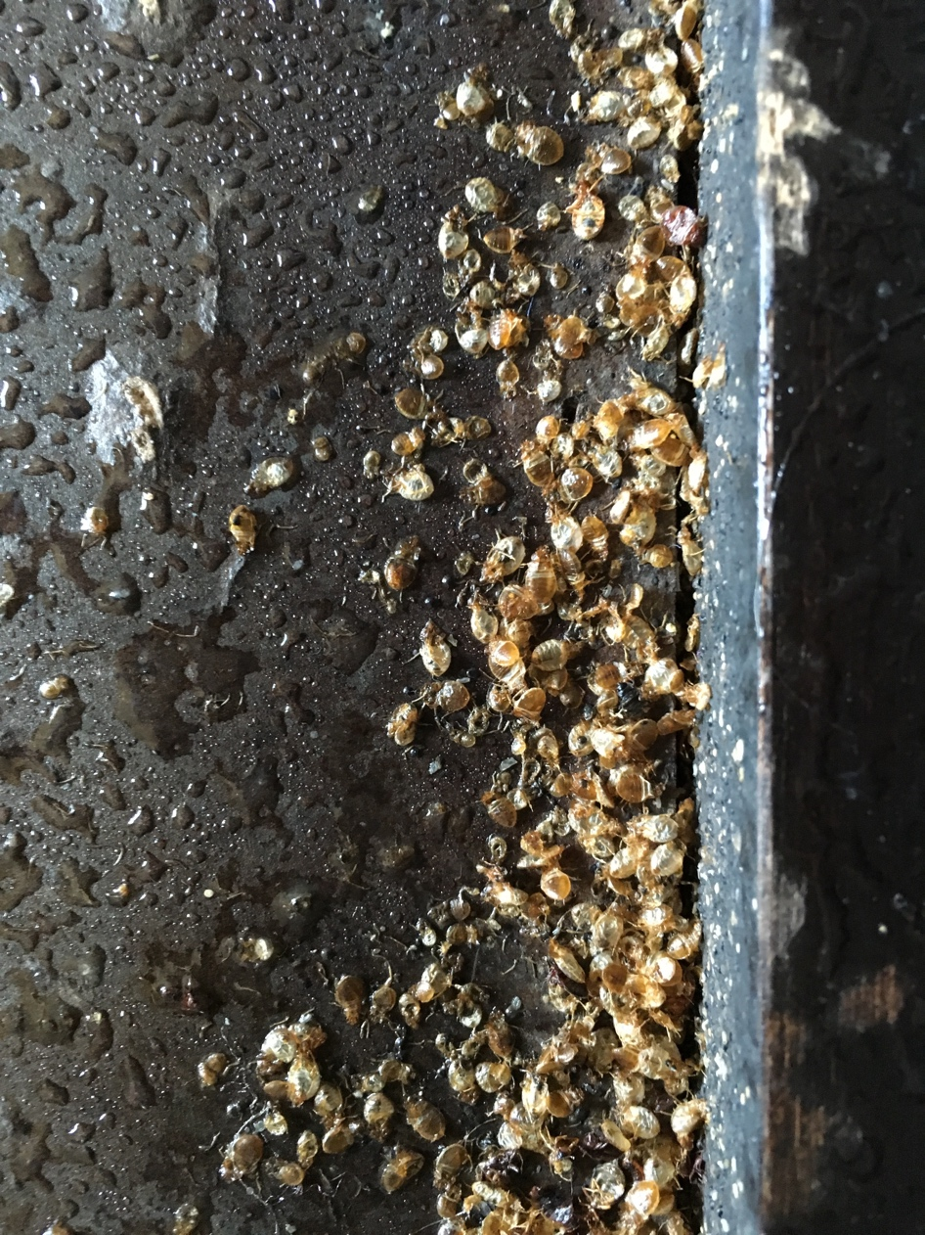
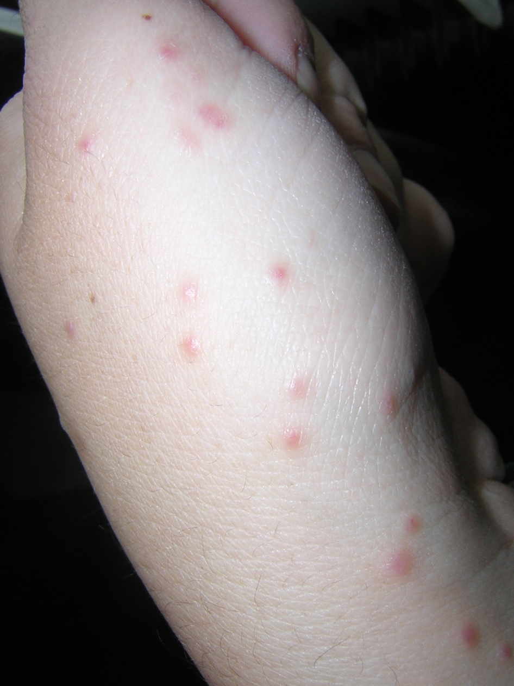
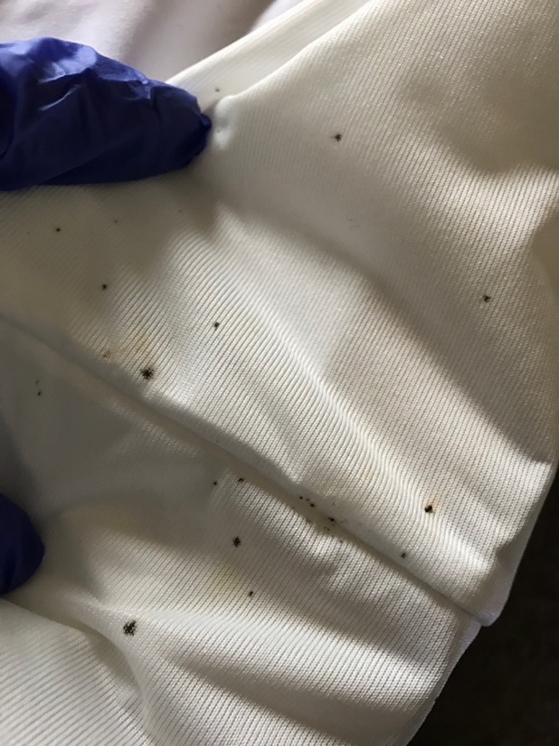
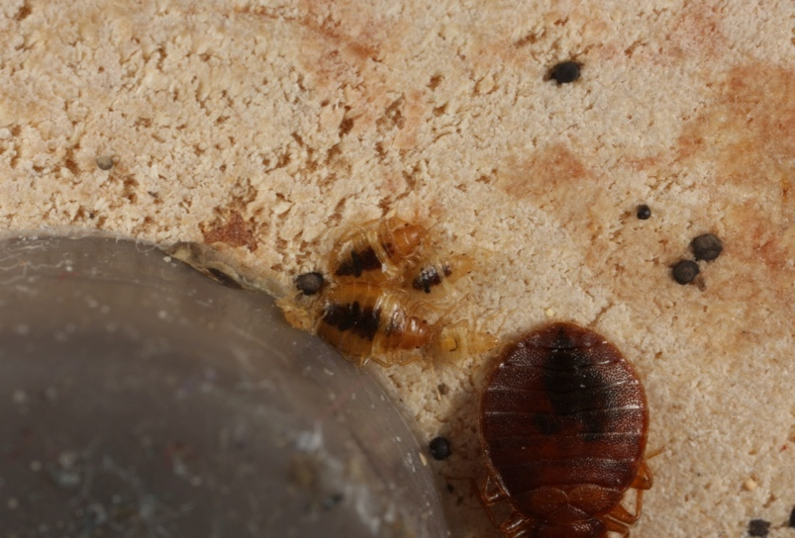
Signs of bed bugs
Bites
Fecal spots
Shed skins
Dead bed bugs
Live bed bugs
Photo: Alex Yelich
Photo: Susannah Reese
Notes:
12
Bed bugs are small and very good at hiding, so a flashlight is needed to see them (or evidence of them).
Keep looking until either a live bed bug is found or all involved feel satisfied that there are no bed bugs.
If bed bugs are found, a few should be put on tape or in a re-sealable plastic bag for identification.
The photo shows bed bugs that were snuggled next to the screw-in foot of a recliner. It took flipping the recliner over to find them. When the foot was unscrewed, more were found.

Slide 13
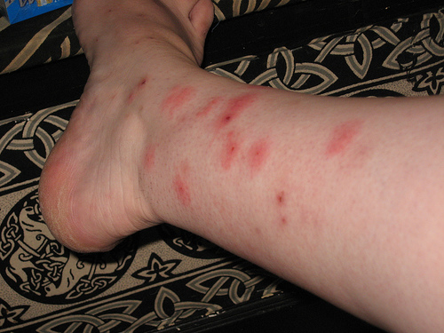
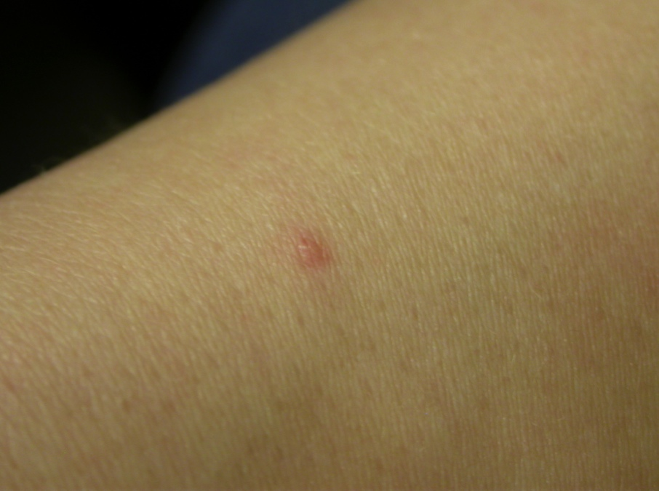
Bites
Bed bugs cannot be confirmed by bites alone—Many people have no reaction
Live bed bugs must be found
Prefer feeding during darkness
Bites often painless
Notes:
There is a myth of bed bug bites always showing up in sets of three in a row: “breakfast, lunch, and dinner.” This is untrue. Bed bugs will come out of hiding to feed when they are hungry (usually once a week), feed until they are full, and then return to their hiding spots, leaving blood spots (bed bug poop) along their route. The bites in a row happen if there are any feeding along the sheet-human intersection or if one is disturbed mid-meal and has to reinsert its mouthpart.
Not everyone reacts to the bites, and a person’s reaction to bed bugs may change over time (not reacting at first, but then reacting after being bitten a number of times).
Anemia in severe cases
Secondary infections
Impetigo
Ecthyma
Lymphangitis
Other pathogens?
Lowe & Romney. 2011. Bedbugs as vectors for drug-resistant bacteria [letter] Emerg. Infect. Dis. (June)
Like head lice: blood sucking ectoparasites
Postulated in transmission of more than 40 human diseases--no
scientific evidence
that transmission has ever occurred (Goddard & deShazo 2009)
Recently shown capable of harboring and transmitting Chagas disease

Slide 14
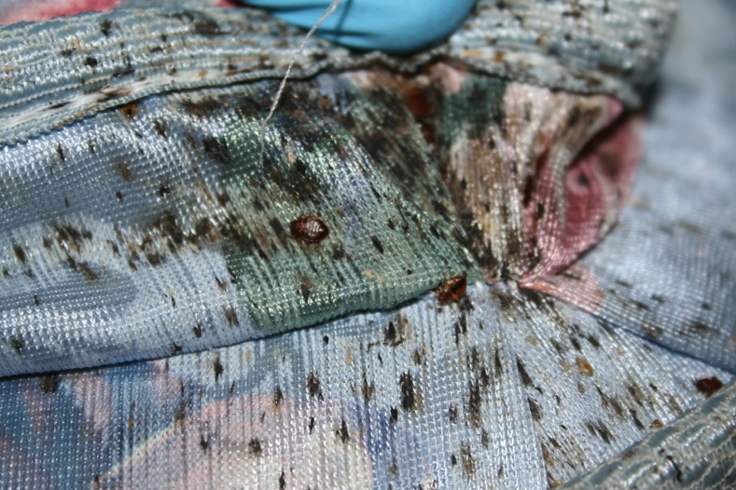
Fecal spots
Fecal spots are bed bug droppings
Different from cockroach frass—frass is gritty, fecal spots are smooth.
A current bed bug infestation cannot be confirmed by fecal spots
alone. Live bed bugs
must be found
A bad infestation
Notes:
Fecal spots are bed bug poop. Some people may have heard them called "blood spots." You may find blood spots on sheets where someone squished a recently fed bed bug, but fecal spots are small dark dots, like the dot a fine tipped sharpie would make. Fecal spots will be found on sheets, pillow cases, mattresses, and around the spot where they are returning to hide. Bed bugs often hide together (as evidenced in the picture above) but not always. Careful inspection with a flashlight must be done to find the spots where they are hiding…especially the loners. One pregnant female could restart an infestation.
You can distinguish fecal spots from cockroach frass. Frass is gritty, like pepper. Fecal spots are smooth.

Slide 15
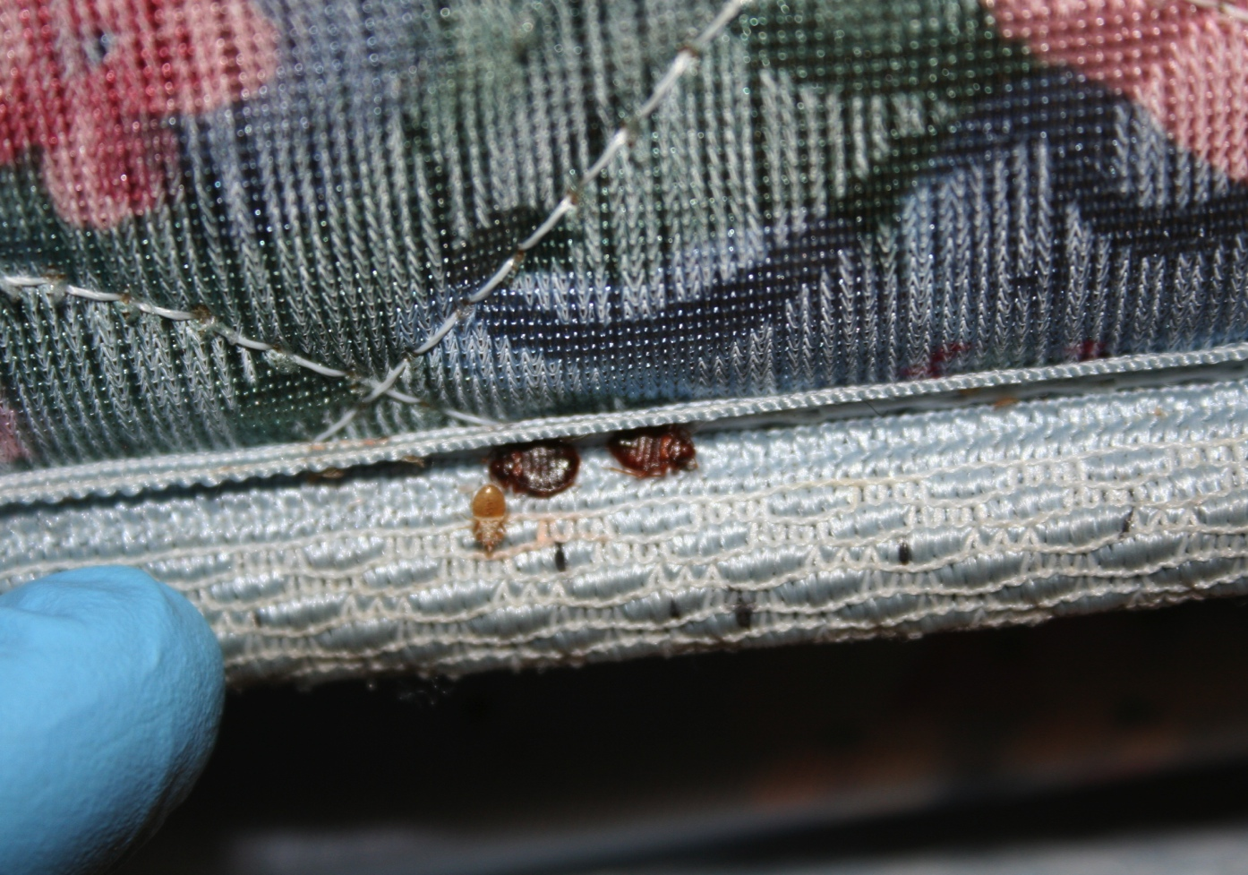
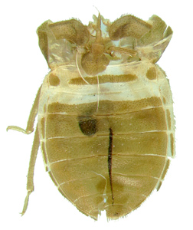
Shed skins
Bed bug signs on a mattress seam
Notes:
Bed bugs don’t have stretchy skin. When they need to grow up, they shed their outer layer—emerging as a larger version. They do this five times, going from the size of a poppy seed to the size of an apple seed. Shed skins look like hollow bed bugs and are the evidence of this growing process.

Slide 16
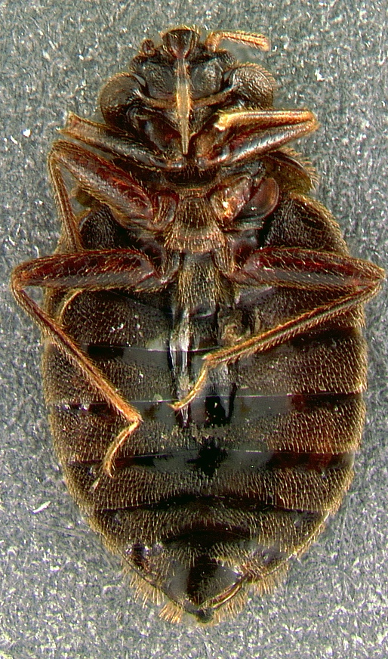
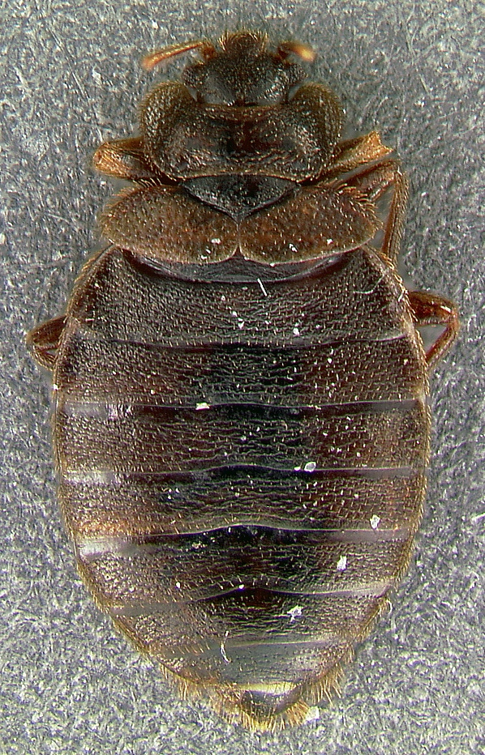
Dead bed bugs
Bottom
Top
Notes:
Bed bugs live for less than a year at room temperature. Dead bed bugs may be found in units that residents have tried to treat. This is particularly of concern if the bed bugs have been killed on the mattress. Many products are not labeled for use on mattresses. If you suspect the resident is putting pesticides on the mattress, someone should talk to the resident and make sure they are following label directions. We recommend vacuuming followed by steam, cryonite, or encasement for mattresses and box springs.

Slide 17
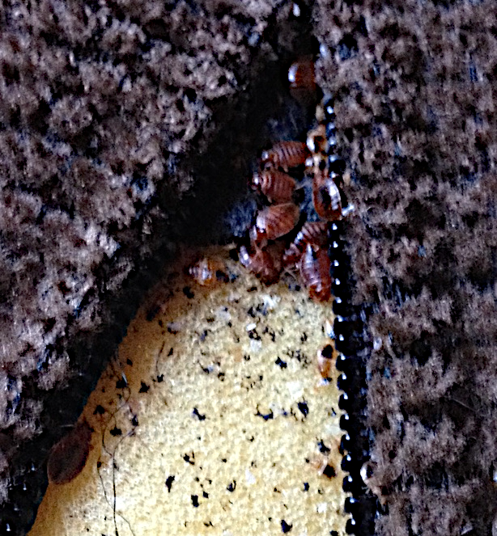
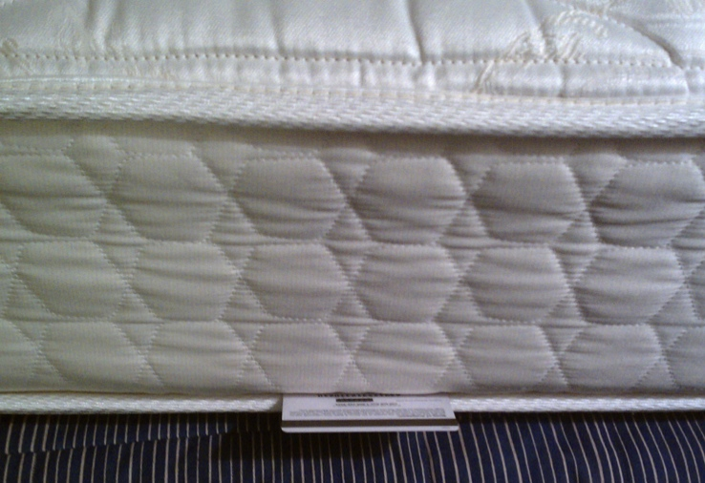
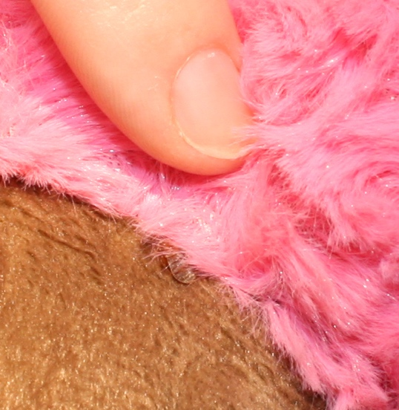
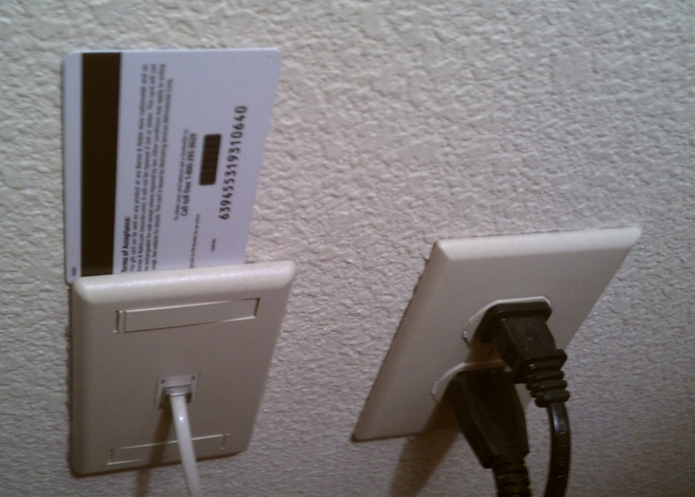
Where bed bugs live
Only inside homes and buildings
In any crack or crevice where a credit card edge could fit
On any item near where people rest
Photo: S. Reese
Couch cushion zippers
Photo: Dr Dawn Gouge
Mattress piping
Stuffed animals
Switch plates
Notes:
Sanitation plays a role in bed bug control because a cluttered apartment will be nearly impossible to treat. Bed bugs can hide anywhere, and cleaning will unearth them. Vacuuming and washing bed linens often will help keep populations from growing.

Slide 18
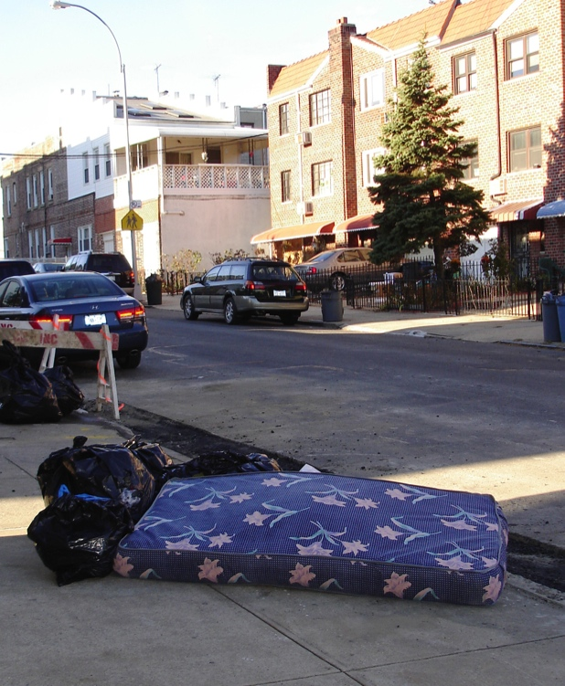
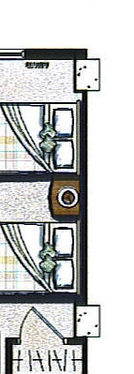
How do bed bugs spread?
Actively crawl along wires, pipes, and under doors
Passively on anything coming from an infested unit (furniture, backpacks, laundry…)
What’s on the other side of the wall?
Notes:
18
Prevention is key.
Since bed bugs are so reliant on humans, they have become very good at staying close to them. In public housing, one infestation can quickly spread throughout the development. The spread usually occurs when:
-residents in adjacent units do not inspect regularly, Bed bugs will travel along pipes or on wires if their food source is removed, or if the infestation gets too crowded. If a unit has bed bugs, all adjacent units should be inspected.
-management does not have the PMP inspect and possibly treat adjacent units,
-infested items are moved through the building without being wrapped in plastic,
-infested items intended for the trash are picked up and brought home,
-staff visits multiple units per day with bags or equipment
-residents visit each other carrying backpacks,
-or bed bugs are brought to the laundry room on bedding and people bring them home from this location.
If infested items are to be brought to the trash: 1. Cover the infested item with plastic for transport through the building. 2. Once outside, make the item unusable by breaking or cutting it open. 3. Put the broken item inside a covered trash receptacle. All these steps help ensure that bed bugs are not spread into uninfested areas within the PHA.
In a 2015 Rutger’s University study conducted in a NJ PHA it was found that 53% of apartments adjacent to infested apartments were also infested

Slide 19

Areas at risk for introduction and infestation
Introduction is likely where people
  frequently travel
  set down personal belongings
  sit or lay down for long periods of time
Infestation is likely where bed bugs can
  Crawl (upholstered furniture or bedding)
  Feed on a person for 5 minutes without being detected
  Hide in cracks or folds
Notes:
Inspect and monitor in these areas to detect bed bug infestations early-on.
Have trainees list areas in the building that are at risk for introduction AND infestation.

Slide 20
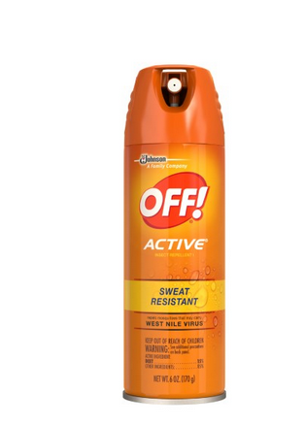
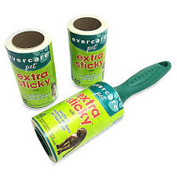
Prevent introduction and spread: staff, health aides, and contractors
In units:
  Prior to entering, use insect repellent
  Avoid sitting or placing items on potentially infested surfaces
  Wear a protective layer when moving infested items
  Inspect after leaving (can use lint roller)
In the main office/community areas:
  Avoid fabric-covered furniture that has many crevices, if replacing purchase plastic or metal items
  Have residents set their belongings in plastic totes during meetings
  Vacuum office regularly
  Use monitors
Bug spray
Notes:
Explain to residents that these precautions (protective layers, plastic totes, etc.) are used community-wide to prevent spreading bed bugs between residents. They are never targeted at an individual resident. It is particularly important to have this conversation when working in a resident's home while wearing protective layers—you don't want the resident to think that you think they are unclean. Bed bugs are not associated with poor sanitation.
If you suspect you have bed bugs on your clothes, change to a clean pair and put the bed bug clothes in a hot dryer for 30 minutes.

Slide 21
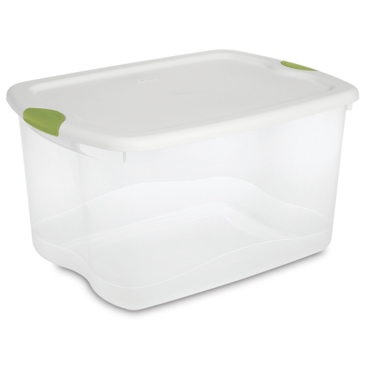
Prevent introduction and spread: residents
Keep coats, backpacks, purses, and bags off beds, recliners, and sofas at home and while out
Inspect used furniture carefully before bringing it home - avoid it if possible
Look for signs when sleeping away from home
Smooth plastic totes can keep clean items bed bug free or contain items with bed bugs
Notes:
Education throughout a development to help prevent bed bugs is worth the PHA‘s time.
Reference: Bed bug poster with a spot where contact info can be filled in.

Slide 22
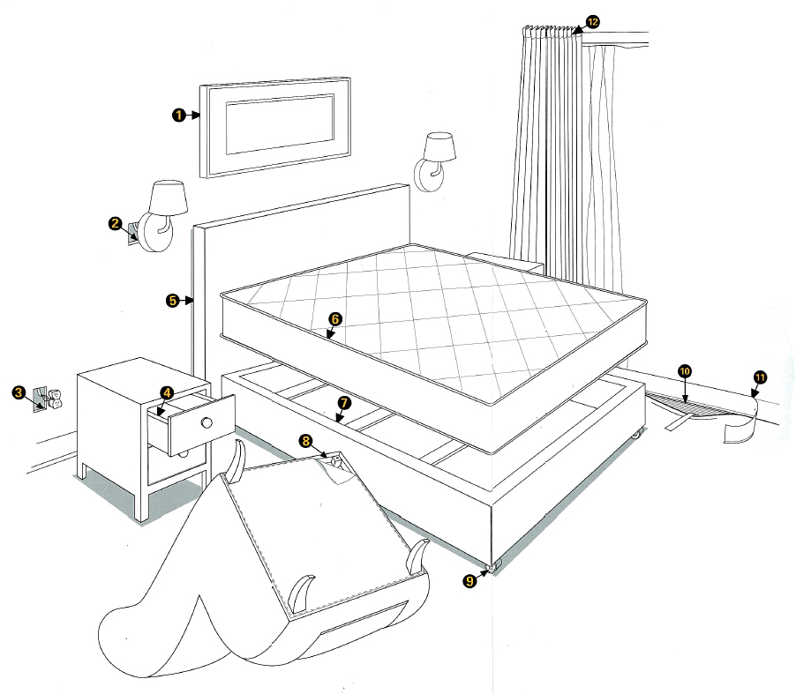
Early detection is key
Early infestations of bed bugs usually are close to the bed and typically take 2-3 treatments.
Advanced infestations spread further, will cost more to control. 5 or more chemical treatments are possible.
Early infestation
Advanced infestation
44% on bed and sofa
70% on
Bed and sofa
23% within 5 ft
56% other harborages
Picture: BASF Corporation
7% Other harborages
Notes:
This slide shows common inspection points for bed bug control companies. Throwing away mattresses doesn’t work because 30%-56% of the bed bugs in a sleeping area aren’t on the bed. The only time bed removal is recommended is for old, heavily infested beds that should be thrown out for other reasons.
Early infestation dispersal (70% on bed) from U of Kentucky. This represents a scenario where there has not been treatment.
Advanced infestation dispersal from Wang et al, Rutgers University and represent a scenario where there has been some treatment of the bed and sofa. But likely the movement away from the bed would be seen in untreated homes as well because bed bugs instinctually disperse and seek out harborages and other food sources.

Slide 23
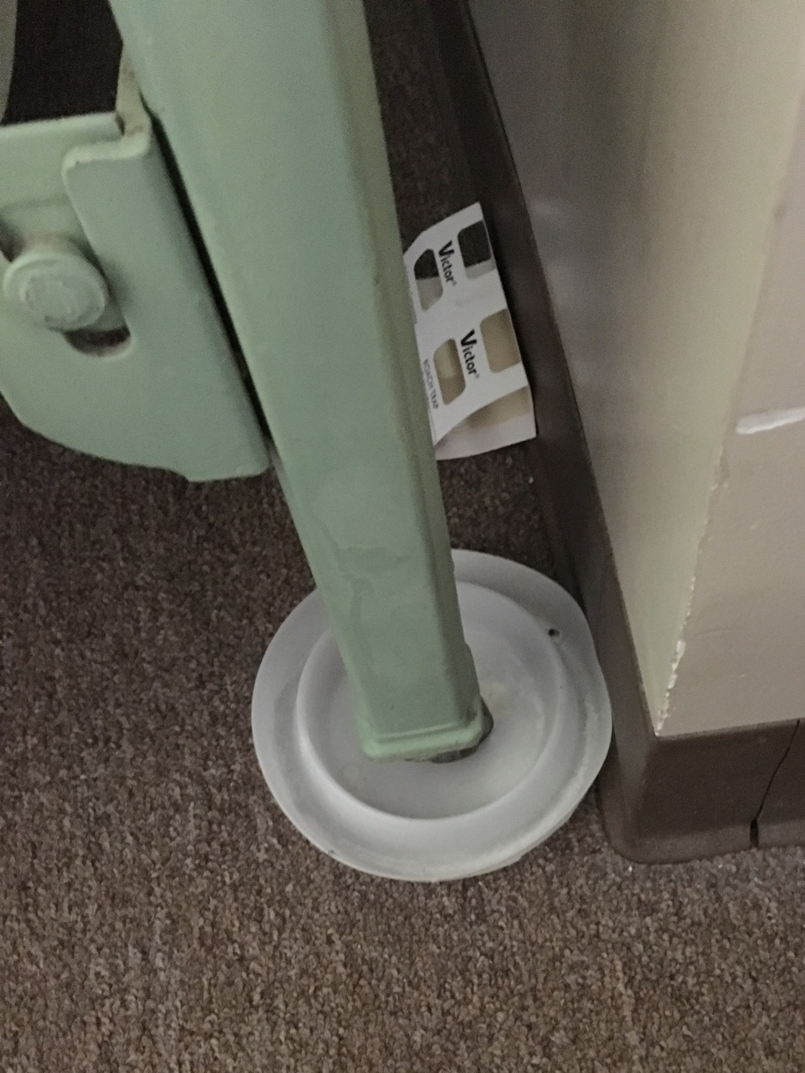
Do not rely on complaints
Many don’t report because:
They are afraid they will be charged $ or evicted
Are embarrassed to complain
Are unaware of the signs
May not react to bites
Use monitors and proactive inspection!
Notes:
According to one study, if you rely on residents reporting you could be missing up to 71% of infested units (Wang, et al. Journal of Medical Entomology, 2016)
Some housing managers wait until there is a complaint before responding to a bed bug problem. That is not good IPM. IPM is proactive and not reactive.

Slide 24
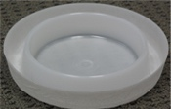
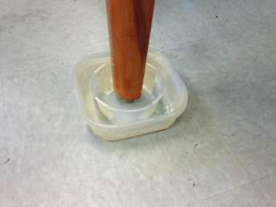
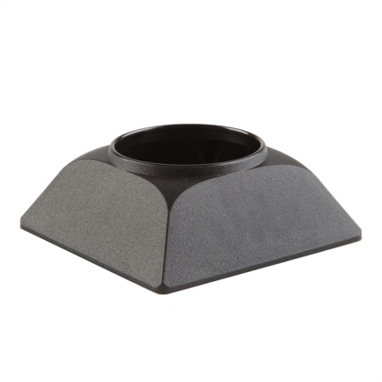
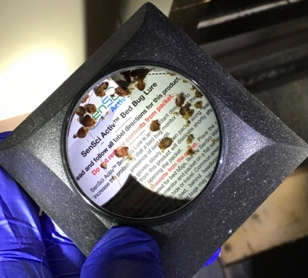
Bed bug monitors
Interceptors plus visual inspection can detect up to 95% of infestations
Trap and kill bed bugs
Determine how bad the infestation is
Two types
  Passive
  Active
Passive, moat-style interceptor (ClimbUp)
Passive, moat-style DIY interceptor from University of Florida/ IFAS Extension
Active monitor, Includes lure (SenSci Activ Volcano)
Notes:
Monitors will not control a bed bug infestation, but they will trap and kill some. More importantly, they help find bed bugs or confirm their presence so that management can take further action. There are two types of monitors for bed bugs: passive monitors do not have an attractant and must be placed where the bugs will walk over them; active monitors have an attractant —a combination of heat, carbon dioxide, and an attractive chemical. Verifi and Nightwatch are still used but they are expensive b/c they rely on Co2 attractant which must be replaced. They can be a valuable tool in vacant units b/c BB tend to become inactive when there is no Co2 present. Verifi Co2 catridges only last 24 hours
Often bed bugs avoid sticky surfaces so sticy trap monitors are not recommended.
Reference: Rutgers University evaluation of monitoring devices: http://www.rci.rutgers.edu/~insects/bedbuginterceptor.pdf

Slide 25
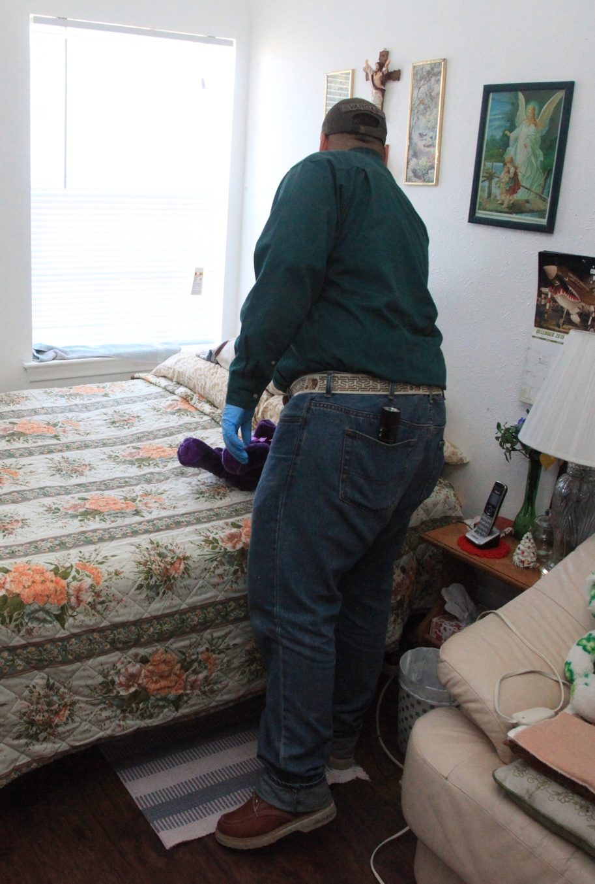
5 or 10 minute Inspection to confirm infestation: Staff
Staff conducts this inspection before professional is called in to confirm infestation
  Inspect beds and sofas only, focus on bed bug signs which are easy to detect
  Faster than detailed inspections
  Suspicious but no live bed bugs found? Leave interceptor traps
Notes:
Dawn Gouge – Inspections about 5 minutes.
Visual inspection PLUS monitors 99% effective at detection*
Wang et al. Journal of Medical Entomology, 2016
Journal of Medical Entomology, 2016, 1–8
doi: 10.1093/jme/tjw018

Slide 26

Professional inspection
Thorough inspection done by professional to find harborages
Two types
  Visual – always use a flashlight!
  Scent detecting canine
If bed bugs are found, inspect and place monitors in all adjacent units and across the hall.
Notes:
Inspections using a bed bug detection canine are especially useful in two scenarios. 1. When a person reports bed bugs but the PMP can’t find any with visual inspection. 2. When a PMP wants to confirm that the area is bed bug-free, for example post- treatment. Canine inspections for bed bugs may identify emerging infestations in their earliest stages, helping property managers gain building-wide control before an infestation spreads to other units, saving considerable time and money.
Inspection with canines is useful for detection, but as with inspection by humans, there is potential for error. You should be able to verify the presence of bed bugs where the dog "alerts" the majority of the time. The dog’s effectiveness depends upon the quality of its training, the ability and consistency of its trainer, and the conditions in the area of inspection. If trained and handled properly, bed bug-sniffing dogs can inspect much more effectively and in a much shorter time than a human. Contact the National Entomology Scent Detection Canine Association (NESDCA) for more information.

Slide 27

Canine inspections
Relatively fast, can detect low-level infestations
Quality of inspection varies greatly
Subject to false positives
Can be expensive
*Speak to your StopPests Consultant for more information
Notes:
Mike Merchant’s slide - is dog alerting?

Slide 28

What about neighboring units?
Should they be inspected?
All surrounding units should be inspected, monitored, and treated if necessary
Depending on infestation level and construction, consider diagonal units as well
No routine treatment of units without signs of bed bugs
Notes:
Mike Merchant’s slide

Slide 29

If someone finds a bed bug
Document all observations
Rapid response plan:
  Save the insect
  Report the problem
  Don’t disturb the area
  Don't apply pesticides
  Prevent carrying the bed bugs to other places. Don’t discard furniture
  Have the PMP inspect the unit and adjacent units
Notes:
Refer back to previous discussions of the IPM log.
Don’t discard furniture before it is determined if it can be treated. Have staff use furniture bags to contain the bugs before moving. Destroy item before leaving it at dumpster or for pick-up
Collect a specimen on a piece of tape or in a jar with a splash of isopropyl (rubbing) alcohol in it.

Slide 30

Integrated pest management for bed bugs
Pesticides
Mechanical controls (encasements,
barriers, vacuum)
Physical controls (heat, cold)
Pest proofing / Sanitation
Education and Awareness
Notes:
Mike’s slide

Slide 31

Education and awareness: Work with tenants
Key Messages:
  Inspect, report, don’t self-treat, don’t throw out furniture or pick up discarded furniture, launder bedding regularly, and vacuum
Classes - Keep it simple.
Posters and brochures – help ID and encourage reporting
One-on-one intervention – when needed
*Your StopPests consultant can provide you with good resources and materials for residents
New York State IPM Program created picture-based, step-by-step bed bug management instructions in English and Spanish for residents. www.nysipm.cornell.edu
Notes:
Ideally, residents routinely
inspect with a flashlight
launder bedding
vacuum
maintain their unit according to housekeeping standards

Slide 32

Work with tenants
Clutter is the biggest customer-oriented challenge in treating bed bugs
See stoppests.org for resources and training on hoarding intervention
Notes:
Photo cred?
Susannsh’s photo?

Slide 33

Clutter image rating scale found in Compulsive Hoarding and Acquiring Workbook
If preparation is required, communicate expectations to the resident using a visual rating scale
Notes:
So that you can make sure the residents are prepared for treatment, ask your PMP about their preparation instructions and how tolerant they are of clutter. Use the Clutter Image Rating Scale as a reference.

Slide 34

Consider resident capabilities and preparation options
Minimal prep is preferred
  avoid moving furniture and bed bugs
  low and moderate infestations = less prep
  PMP guides customers on how to handle clothing, curtains, etc. after first inspection
Notes:
No good to bag unless it is laundered
Remove bedding and clean out under bed is reasonable mionimal prep.
No automatic full prep. Negotiate a level of prep based on level of infestations and the type of treatment. For example laundering every cloth item may not be necessary. Just the items in and around the bed.

Slide 35
Who is responsible?
Assign realistic preparation responsibilities, taking into consideration the disabilities and financial, and physical limitations of those involved
Instructions are ideally carried out by resident
If they are unable
Family & friends
Building staff
Aides
Nonprofit groups
Contracted companies
If they are unwilling
Fall back on lease, job description, or other existing formal agreement
*Talk to your StopPests consultant for guidance on preparation and working with residents
Notes:
The purpose of trash management to control bed bugs is to limit the chances that discarded, infested items will be brought back into the building. A team effort is necessary to control bed bugs.
It is not the job of the housekeeping or maintenance staff to clean all the units, but if support service staff know of residents who cannot inspect (poor eyesight, weak, or disabled), they should find a way to help the resident clean and inspect.
Suggestion: Make sure the question of who is going to take apart and reassemble furniture is answered.

Slide 36

Encourage a community response
Educate everyone
Destroy discarded items
PHA could take the financial burden off of residents by providing
  mattress encasements
  monitors
  proper furniture removal (if needed)
Notes:
Mattresses and furniture with bed bugs do not have to be thrown away.
If mattresses are to be kept, use a fabric mattress encasement. Bed bugs can crawl out of tiny rips so the most important factor in using a mattress encasement is that it does not rip. Vinyl or plastic covers will not work. Encasements with bed-bug-proof zippers are ideal. The box spring can also be encased.
If no food is available within a few hundred feet or they are trapped, bed bugs will go dormant. They are thought to be able to live without feeding for many months. Because of this, it is critical that the mattress encasement stay on and intact (closed) for at least six months.
If appropriate, the mattress may be treated with pesticides available to a PMP. Pesticides should not be used on children’s furniture or around chemically sensitive people. Steam or cryonite are preferred for killing bed bugs on mattresses.
Movement of infested items throughout the development may spread bed bugs. If items are moved through the building, make sure they are covered in plastic and made unusable once they are outside (cutting open the mattress in multiple spots will work).

Slide 37
Know your treatment options
Vacuuming
Isolation
  Encasements
  Clear bags
  Closed plastic containers
  Make the bed an island
Freezing*^{not} ^{as} ^{reliable} ^{as} ^{heat}
  Chest freezer
Heat
  Clothes dryer
  Steam
  Container
  Whole unit
Pesticides
  Spray
  Dust
  Fumigation
Notes:
Liquid CO_{2 - _ not reliable}
Outside temps are not reliable.
Since bed bugs feed only on blood, control is different.
Although there are many things that a homeowner or resident can do to help treat bed bugs, this training encourages getting a PMP involved ASAP rather than taking time to treat the problem without one. Each pest management company should have instructions for residents on how to prepare the unit for a treatment.
Vacuuming
Every bed bug treatment will likely involve some vacuuming—even if it’s just the floors to make the PMP’s job easier. Vacuums are useful in medium and high infestations for getting rid of a lot of bed bugs relatively quickly without using pesticides. The same goes for cockroaches. We recommend using a bag vacuum with a HEPA filter and having a spatula or other tool available for dislodging bed bugs as you vacuum. As soon as you’re done using the vacuum, take the bag out seal it in a plastic bag, and throw it out. If all you have is a canister vacuum, you can use that too. After every use empty the canister into a bag, tie it off, throw it away, and wash out the canister. Either way, if you have to shut off the vacuum mid-job, plug up the hose with a paper towel. This will prevent bed bugs from crawling back out the hose and will wipe the inside of the hose when you turn the vacuum back on. If a vacuum will be used in many different areas, inspect it to make sure you don’t carry any hitchhikers.
If you don't want to deal with changing the bag, get one knee-high pantyhose and stuff the toe down the vacuum hose at the sucking end. Keep pushing it down the hose until about 8 inches are sticking out. Fold the open end of the pantyhose over the vacuum nozzle (like you fold a trash bag over the edge of a trash can) and secure it with a rubber band. Put the crevice tool on the vacuum hose over the pantyhose. The bugs will get trapped in the pantyhose and when you are done you can remove the rubber band, tie off the pantyhose, and pull it out for disposal.
Isolation
Encasements are discussed on the next slide.
Bed bugs can’t claw or chew through plastic. They’re also not great at climbing up smooth metal, plastic, or glass. Adding a light dusting of baby powder to the sides of a container makes it nearly impossible for them to climb up and out. You can take advantage of this in your management plan by using plastic totes, sealed bags, and encasements. Pulling the bed frame away from the wall and any surrounding furniture and putting insect interceptors under bed frame legs also isolates the bed.
Freezing
Two types of equipment will freeze bed bugs. Freezers that reach 0°F or colder can work for bed bugs. Although research is ongoing, it seems an object must reach 0°F for 3 days to kill all life stages of bed bugs. If it’s not that cold, it will take longer. Household freezer temperatures vary too much to depend on.
PMPs may offer a freezing treatment that uses dry ice. The equipment is designed to spray the dry ice snow over objects—flash freezing the bed bugs and their eggs. Only a professional should use this method. This system isn’t used exclusively, it’s usually a good option for sensitive objects like fine art.
Heat
Bed bugs and their eggs die when exposed to anything that is 120°F for about 30 minutes. Some companies have equipment—including heaters, fans, monitors, and computer programs for tracking temperatures—to heat up an entire area. Not every large area can be brought to a high enough temperature for a long enough time. The key to any heat treatment is to get every inch of every object at least 120°F. Paper, clothes, and carpet are all insulators that may block the heat. The PMP will have to move objects around and use fans to get the heat everywhere. Bed bugs that hide behind switch plates or baseboards may crawl into the wall void and escape. To get those bugs, the PMP will treat the voids with a pesticide dust. You will have to prepare for a heat treatment because some common items can’t take the heat.
Heat treatments are also available on a smaller scale. The same target temperatures and concerns apply. For luggage and other small items there are portable heat chamber options that anyone can purchase and use. Larger objects can be isolated in a chamber and heated up.
The hot setting on a dryer is one of the best options for bed bug management programs because of accessibility and ease of use. Dry fabric will be de-infested after 30 minutes on the hottest setting in a dryer. Even dry-clean-only items can go in a dryer—it’s water that these fabrics can’t stand. If the fabric is wet, run the dryer for the full cycle.
Steam is another heat option. You can use a commercial-grade steamer to kill bed bugs and their eggs. The target temperature is still at least 120°F, but steamers get much hotter than that—around 200°F. That’s hot. Be careful when using steam, both heat and water can damage objects and steam will conduct electricity. To ensure the killing temperature gets into every crack and crevice, move the nozzle head very slowly. To keep moisture down and reduce the likelihood of blowing bed bugs away without killing then, cover the nozzle head with a towel.
Pesticides that are legal for use against bed bugs will list bed bugs on the label. Most are sprays or dusts. EPA’s bed bug website has a bed bug pesticide search tool. The label is the law—follow it closely. Even botanical products and other least toxic pesticides pose risks. If you have pesticide questions, call or visit the National Pesticide Information Center. Many pesticide products don’t keep killing once they’re dry (no residual). You may have to do some preparation in the area so that the PMP can access all areas for treatment.
For an in-depth discussion see What's Working for Bed Bug Control in Multifamily Housing at http://www.nchh.org/Portals/0/Contents/bedbug_report.pdf
Suggestion: if the PHA’s PMP is present at the training, ask him or her what residents are instructed to do and have a discussion about who would help do this preparation for an elderly or disabled resident.

Slide 38

Mattress encasements
Vacuum bed bugs you can see
Cover any sharp points
Cover mattresses and box springs
Ensure a snug fit, zip, seal,
and check for rips
Leave it on for 1 year
Can eliminate the need to treat mattresses
Encases any remaining bed bugs so they cannot bite
Use encasements rather than discarding
Notes:
38
Use fabric encasements designed for bed bugs. The encasement drastically simplifies inspection, making early detection easier especially on the box spring which has lots of spots where bed bugs can hide. The most common site of escape is through the zipper and bed bug encasements have special zippers. Most bed bugs will die within 5 months, but leave the encasement on and sealed just in case.

Slide 39


Heat
Whole unit heat treatment
Portable heat chambers
Steam – (training needed)
Clothes dryers – 30min on high
Building staff at a property in Pennsylvania inside their new ZappBug portable heat chamber.
  Consider offering free tokens or one machine designated for bed bug treatment only
That’s a rug in a dryer!
Notes:
Heat chambers are an option to heat difficult to treat items. The ZappBug model is easy to assemble, effective and the least expensive at about $1500

Slide 40

Steam
Provides immediate kill of all life stages
Penetrates into cracks and 1-2 cm into fabric, up to 6 cm in cracks
No pesticide residue
Slow!
Photo: Susannah Reese

Slide 41

Pesticides
Only PMPs should use
Bed bugs tolerant of many insecticides
Types of formulations
  Aerosols
  Dusts
  Fumigants
  Sprays
The label is the law!
Notes:
Pesticides are no panacea for bed bugs; but they are useful tools within the context of an IPM effort.

Slide 42




Understanding chemical treatments
There is no silver bullet.
Pesticide sprays have limited residual effect
Most sprays only work on contact
The most effective chemicals are combination products (neonicotinoids + pyrethroids)
Dusts are effective as long as they are kept dry
*Ask your StopPests consultant for advice on product efficacy
Notes:
Combo products include Tandem, Transport and Temprid, and Bedlam PLUS
Chemical dusts work better even on pyrethroid resistant pop b/c bed bugs take up more chemical when they walk through.
Although there is some talk of resistance building Phantom (w chlorphenapyr a pyrrole) it still can be effective
There is no evidence yet of resistance building to non-chemical desiccant dusts (Show CimeXa and DE here)

Slide 43

Only PMPs use sprays
Sprays are not effective when used by tenants for bed bug control
Over-the-counter-sprays and foggers cause the bugs to scatter so the problem becomes harder to deal with
Notes:
43
Mike merchant’s picture on rt.
Sprays should not have to be used by the PMP for cockroaches and rodents, but since there are few other options for bed bug management, sprays may need to be used.
“Do It Yourself” sprays may be repellent, causing bed bugs to move away from the treated area. Their use can spread the problem, making the bed bugs harder to deal with and MORE expensive for a professional to treat (because of a larger treatment area). PMPs have the expertise and products to treat bed bugs. Residents should focus their efforts on nonchemical control practices.
Sprays should not be used in the units occupied by people with chemical sensitivities, or in adjacent or neighboring units, common areas (such as the halls, lobby, laundry room, elevator, or stairs), or along paths of travel. Infants and children, the elderly, and pregnant women are at greater risk for adverse health effects associated with exposure to pesticides and thus it makes sense to use reduced risk practices, follow label instructions, and practice prevention-based approaches that reduce reliance on chemical control measures.

Slide 44

Find a good contractor and provide oversight
Property managers MUST:
Oversee contractors
Keep records of progress and reduction of pest population
PMPs MUST:
Report monitoring results. How else will we know if treatment worked and the contractor is doing the job?
Both:
Decide which units need attention (not complaint-based)
Confirm elimination
http://citybugs.tamu.edu/factsheets/biting-stinging/bed-bugs/
Notes:
Elimination standard should be no bed bugs found during two consecutive visits based on resident interview, visual inspection, and monitors.

Slide 45

The PMP's role
ALWAYS thoroughly inspects the reporting unit and the adjacent areas
Provides site-specific preparation guidelines
Follows the label
Returns to inspect every two weeks and treat if bed bugs are found and follows-up until bed bugs are not found for two - three consecutive visits
Photo: Susannah Reese

Slide 46

Mix it up
Heat - steam, chamber
  With optional residual insecticides
Pesticide-based
  Barriers
  Dusts
  Residual sprays
Vacuum and encasements – all treatments

Slide 47

Module Review (Workplan)
What will you do now?
Who does what?
Contract/Policy requirements
Education
Monitoring
Preparation
Laundry
Encasements
Visual inspection
Furniture removal
Review records
Monitors in all or high risk units
Inspect neighboring units
Assessment-based Prep Instructions
Use of:
  Steam
  Heat
  Sprays
Follow-up treatment/schedule based on monitor counts every 2 weeks
Confirm elimination
  Dusts
  Vacuum

Slide 48

Questions?
Notes:
Rev. 8-10-17
This presentation focuses on bed bugs. It covers the biology, behavior, and what you should do up to the point where the PMP gets involved. From there, follow the pest control company's procedure.
Reference: For an evaluation of bed bug control options, see: http://www.nchh.org/Portals/0/Contents/bedbug_report.pdf

